Slide 1
Continuous Delivery at Suncor's Digital Bay; Mining Maintenance meets DevOps

Slide 2
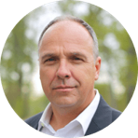
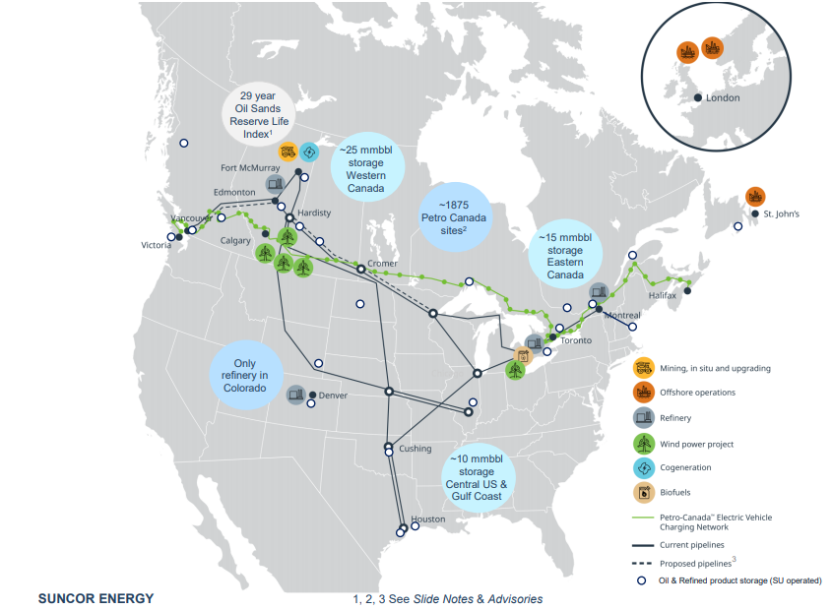
Our Global Operations
Notes:
Our operations include:​
Oil sands development & upgrading​
Conventional and offshore production​
Petroleum refining​
Product marketing (Petro-Canada)​

Slide 3






Six priorities: our roadmap for the future
Grow long-term returns on invested capital
Be a net-zero greenhouse gas (GHG) emissions company by 2050, and substantially contribute to society’s net-zero goals
Sustain and optimize our base business while improving cost and carbon competitiveness
Grow low GHG emissions businesses that will materially contribute to earnings and cash flow
Grow our customer connection through new low-carbon products and services
Achieve world-class ESG performance and disclosure while being recognized as a leader in sustainability and the energy transition

Slide 4


Our transformation journey with DevOps
The world is changing…and so is Suncor
User experience
Operations
Disruption
Business models (e.g.: Ride sharing, self-service ecommerce, etc.)
Great place to work
Building trust in and across teams
Building digital capability
Fostering psychological safety
Innovation
Time-to-Value
Realizing value ASAP
Small increments
Rapid feedback loops
Technology
Emerging technology
Rapid Pace of change
Artificial intelligence
Big data combinatorial
Cost focus
Lean thinking to remove waste
Minimizing rework
Prioritizing based on value
Mindset
Product
Intrapreneurial
Customer-centricity
Focus is on the customer
Breaking down silos

Slide 5

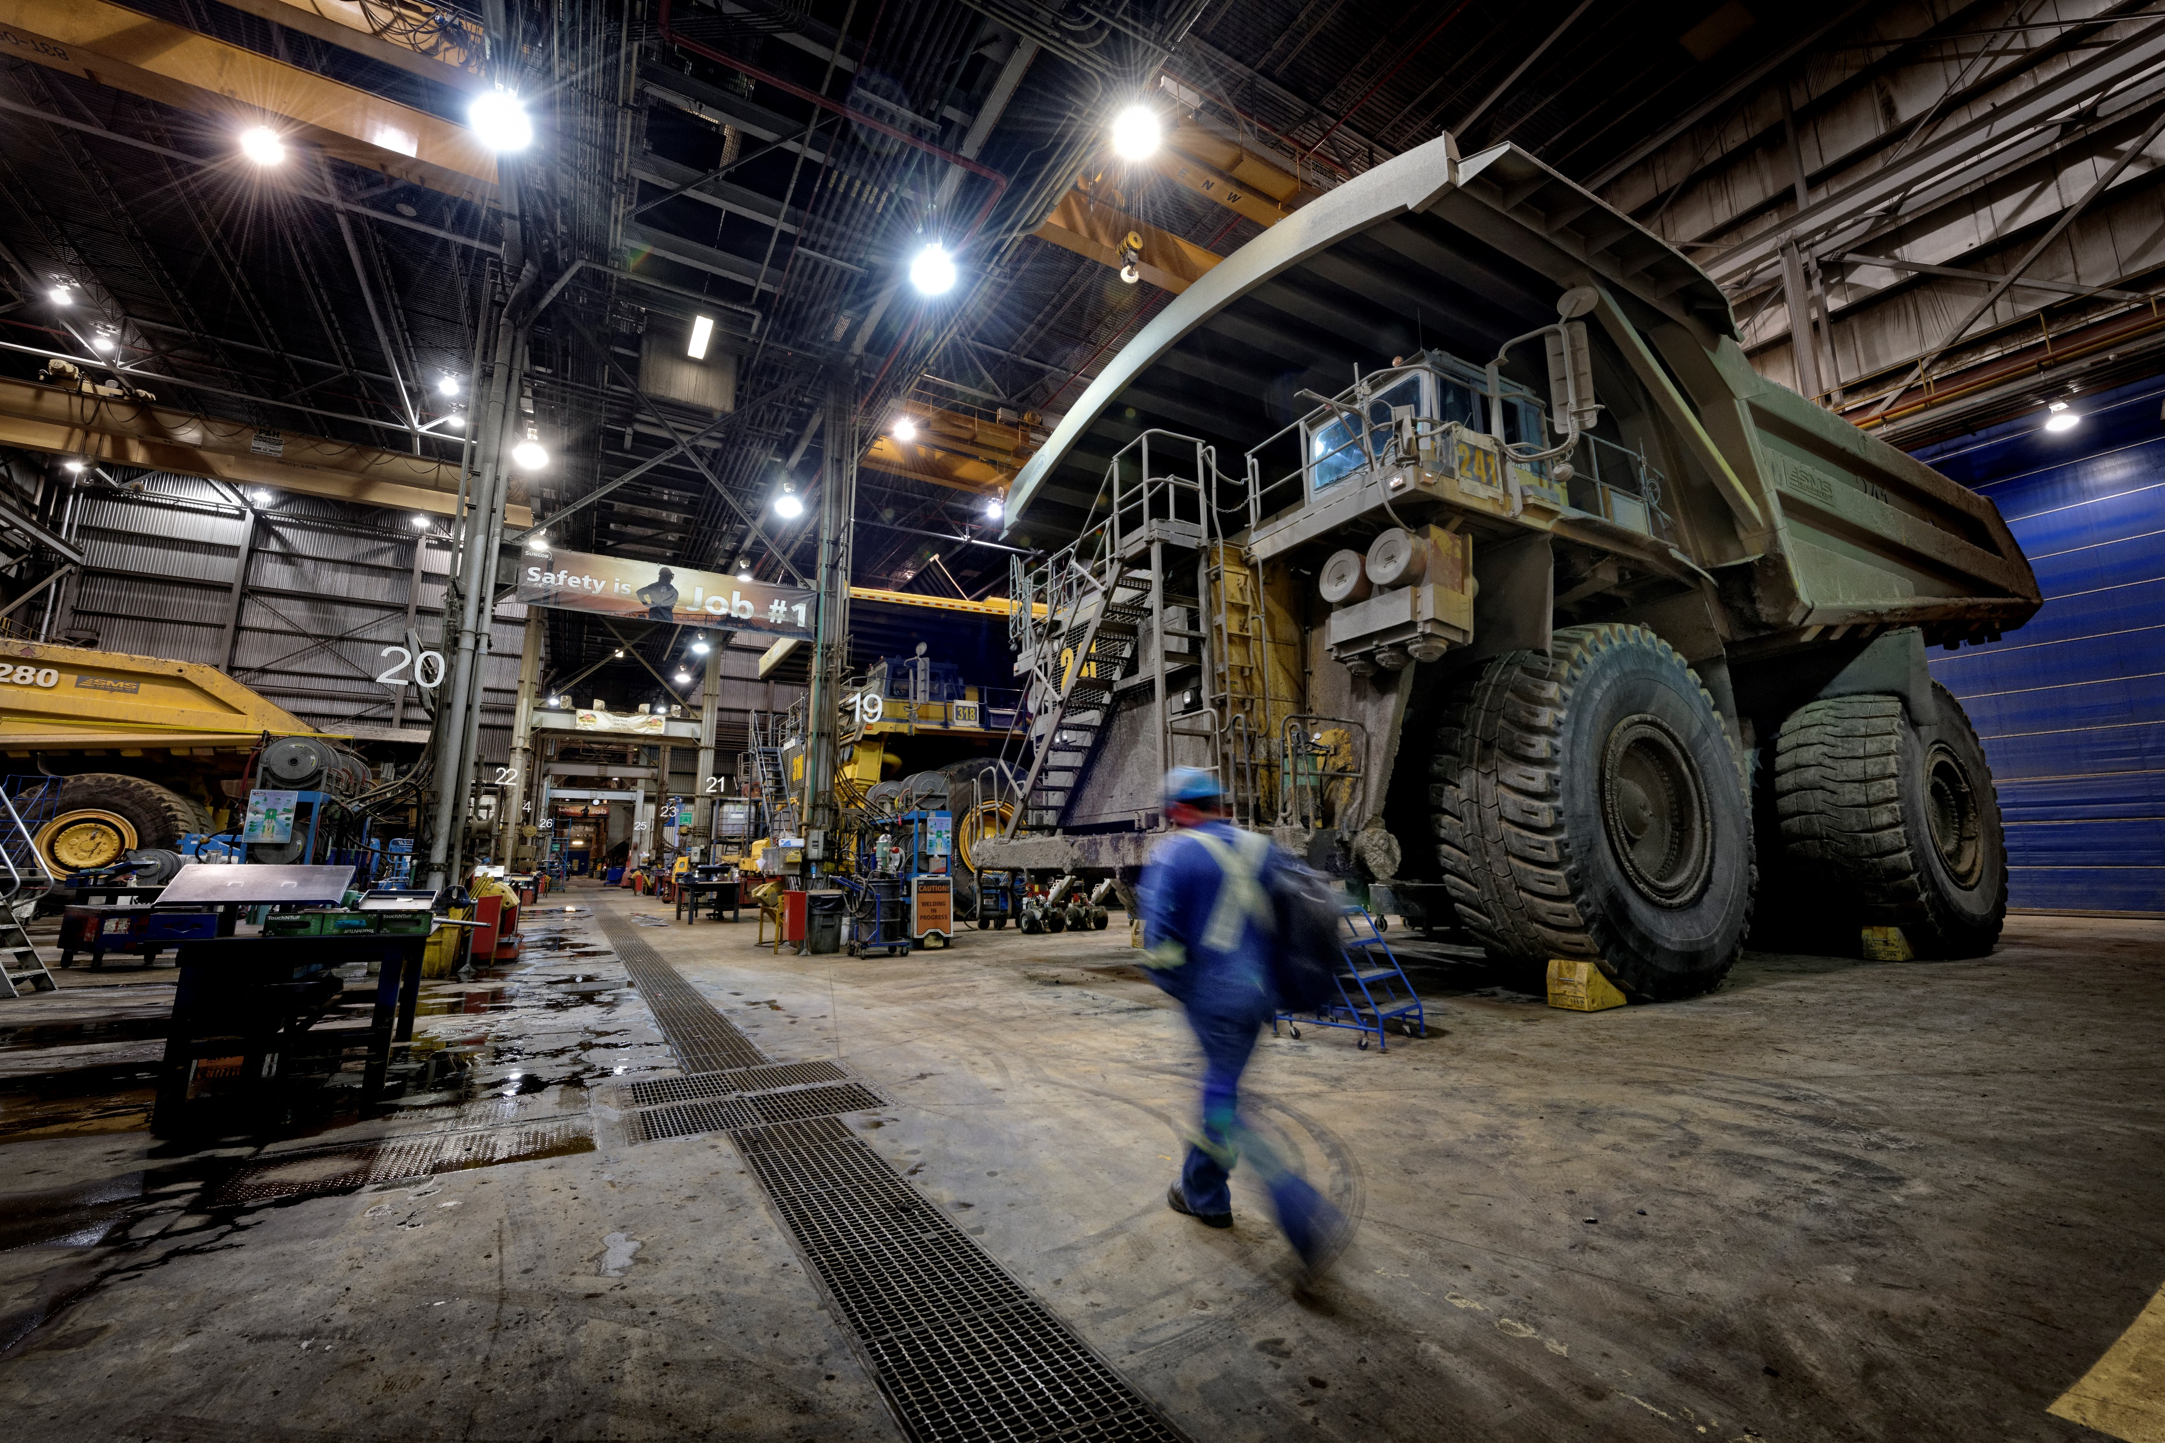
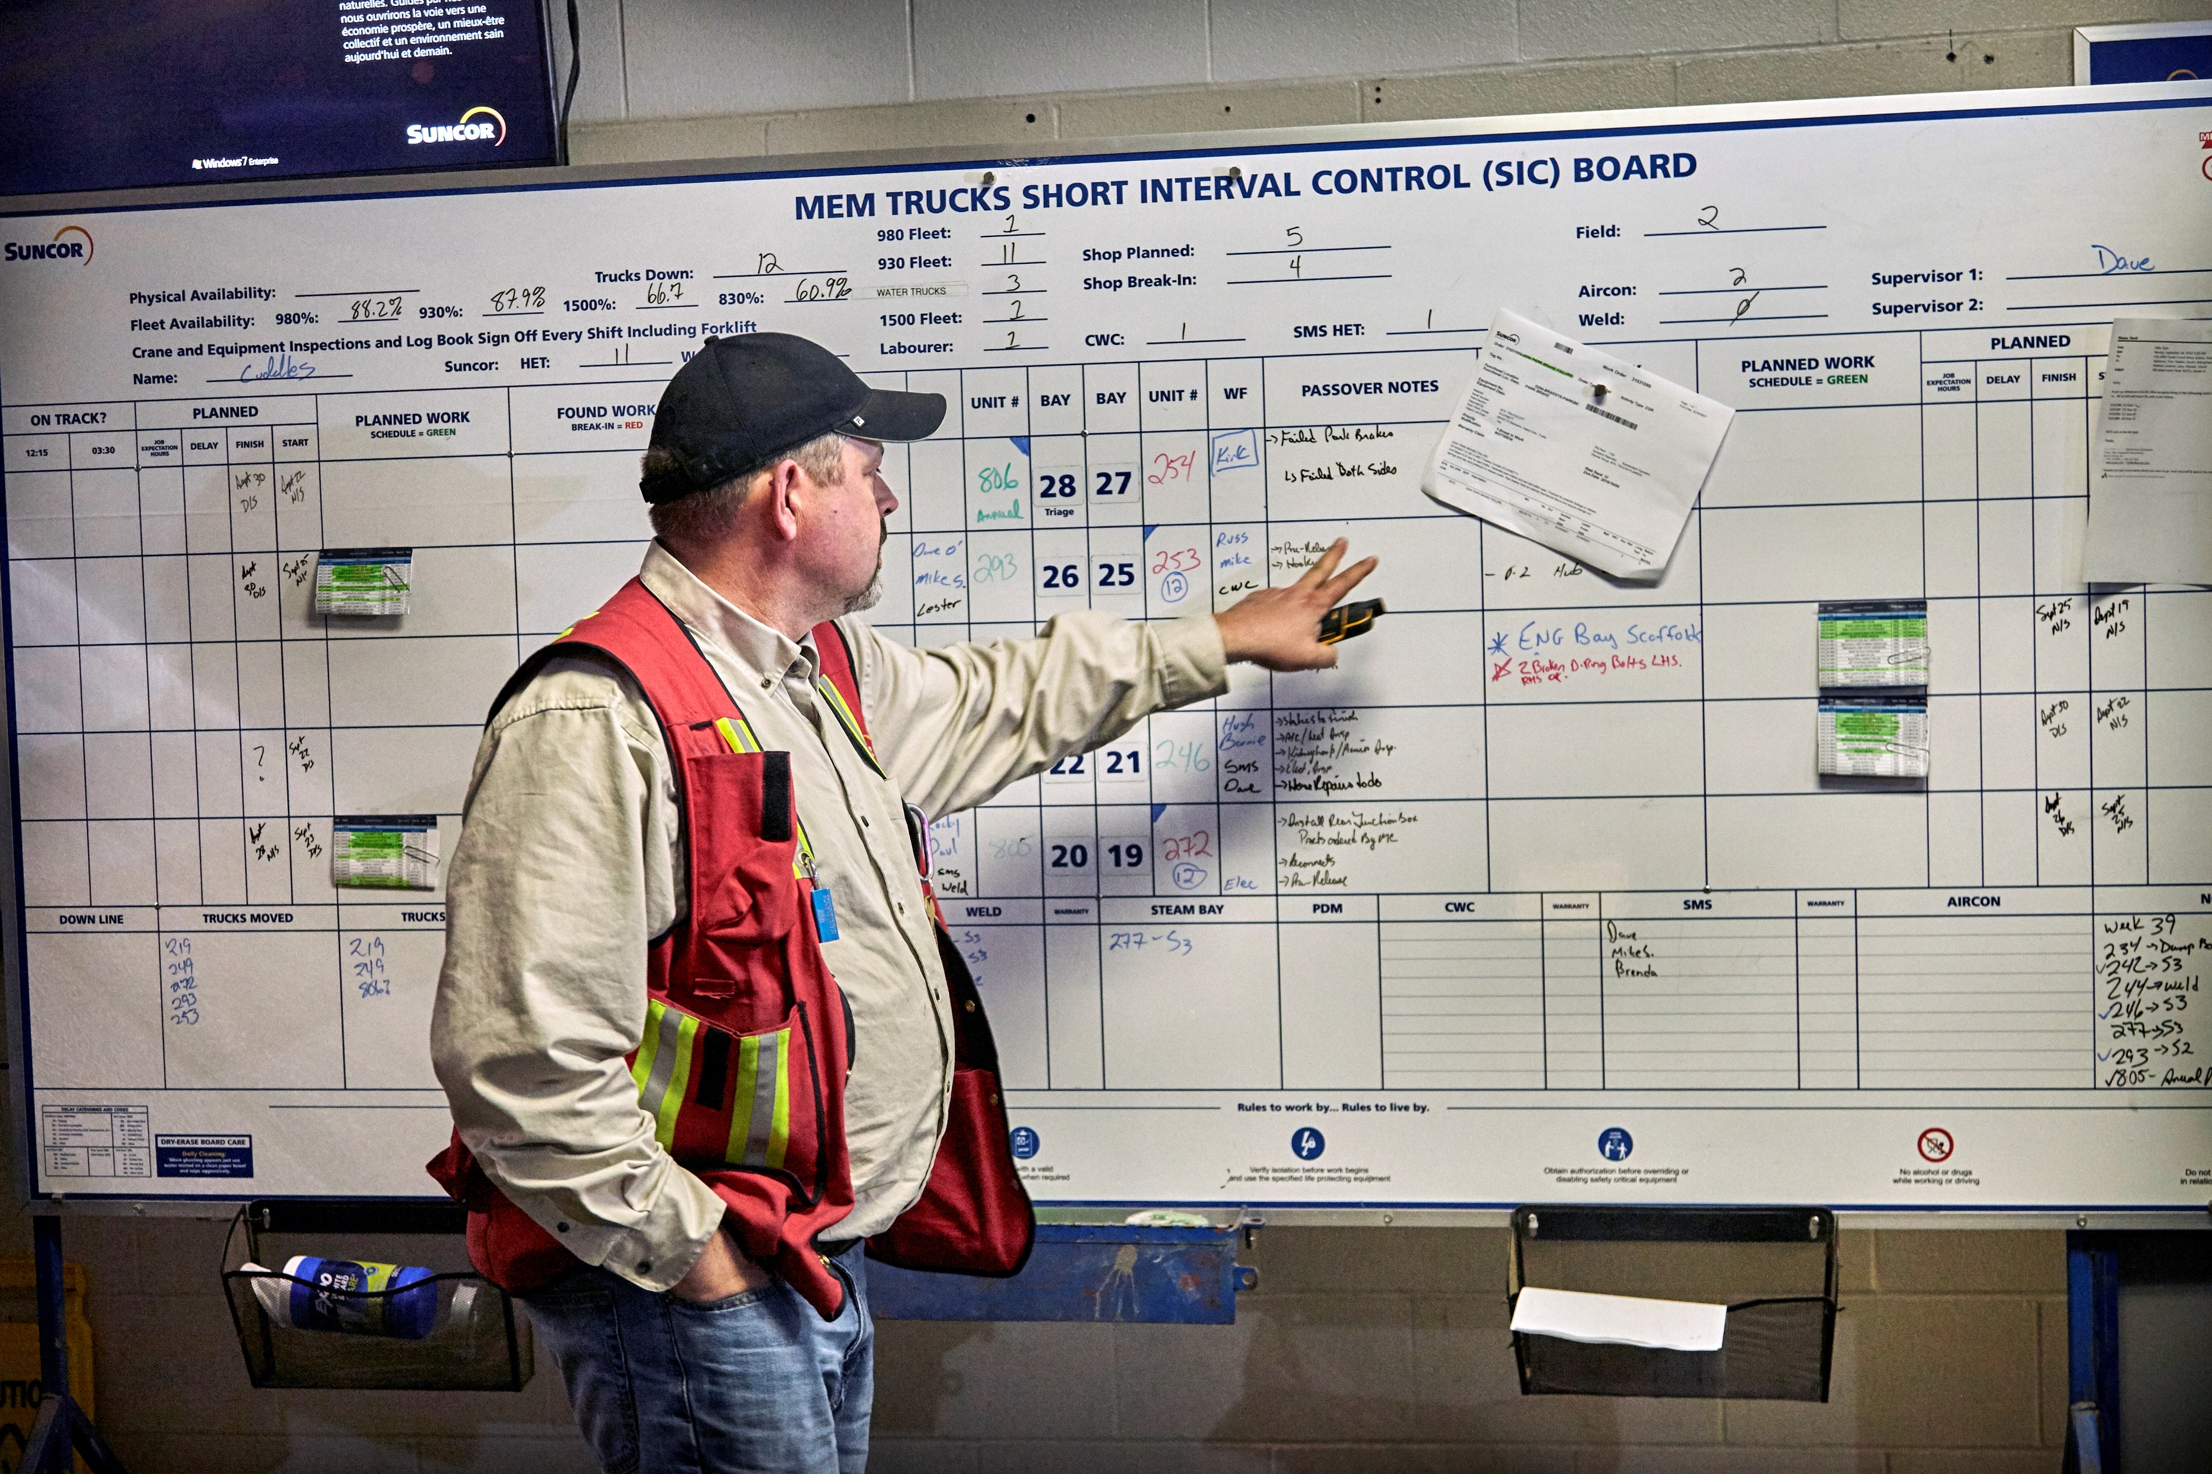
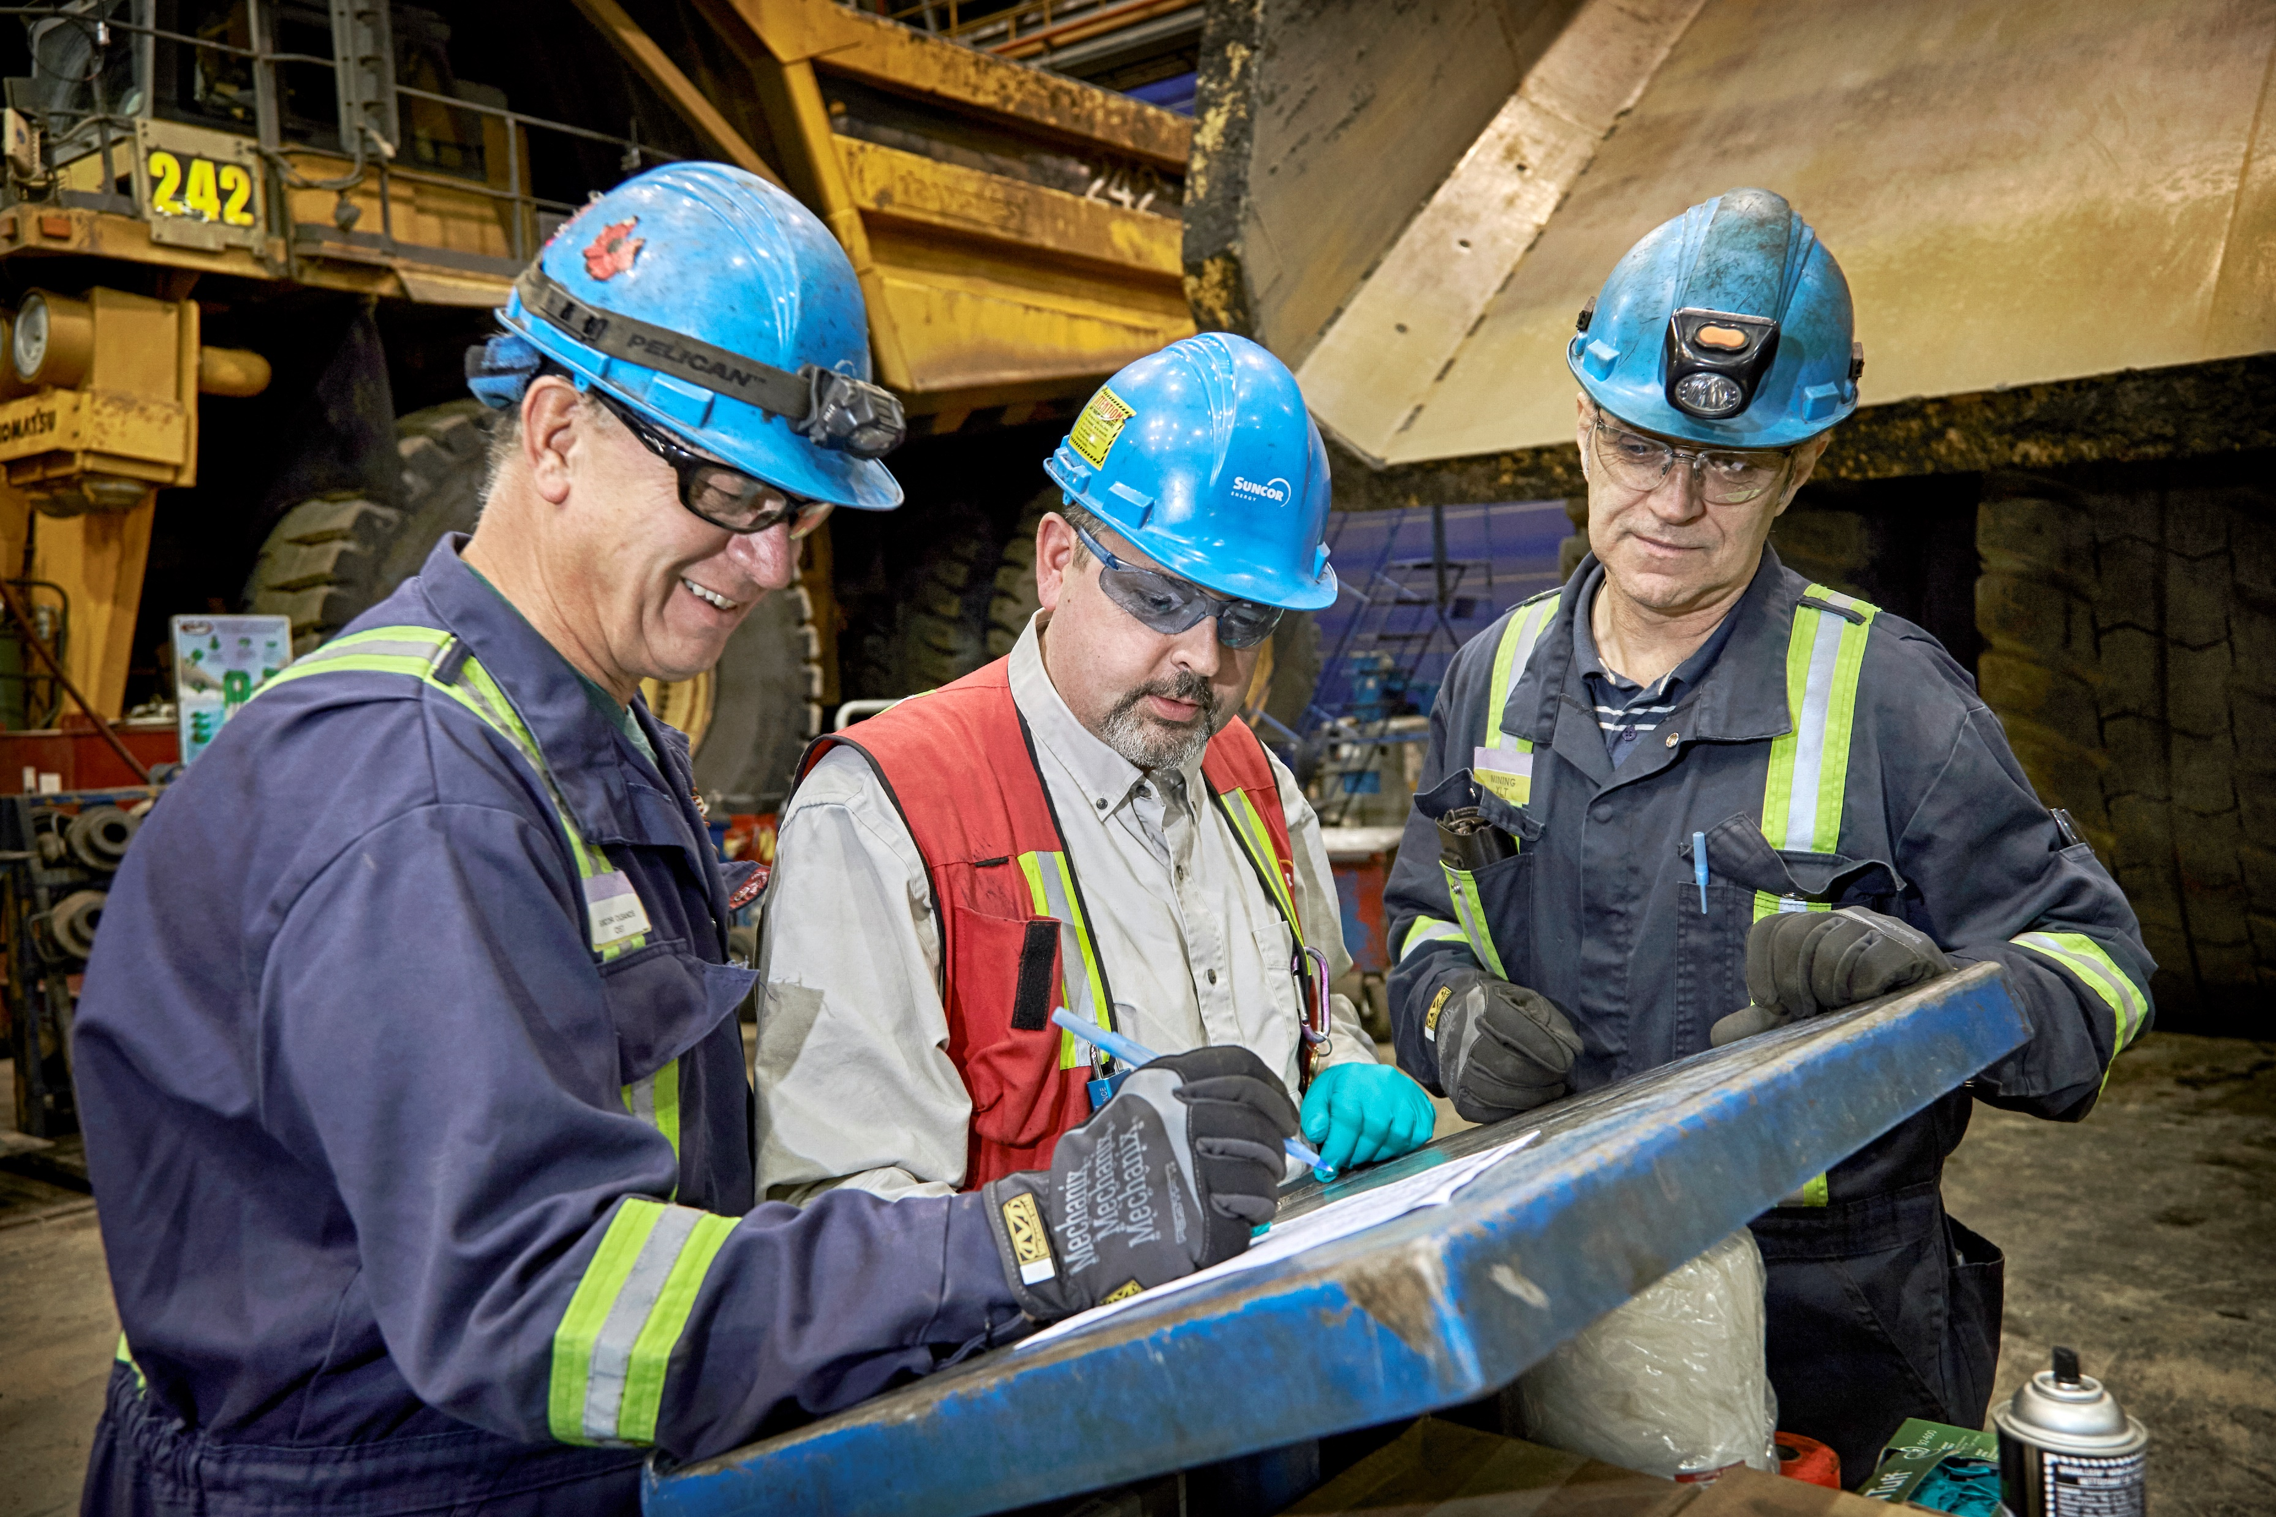
Mobile maintenance in the Mine
Suncor currently owns, operates and maintains over 200 ultra class fleet (320+ tonne) haul trucks
These haul trucks operate 24/7/365
Minimizing downtime and maximizing material moved with these trucks results in value
Increasing the efficiency on the maintenance performed allows the truck to return to work as quick as possible.
Notes:
Our operations include:​
Oil sands development & upgrading​
Conventional and offshore production​
Petroleum refining​
Product marketing (Petro-Canada)​

Slide 6
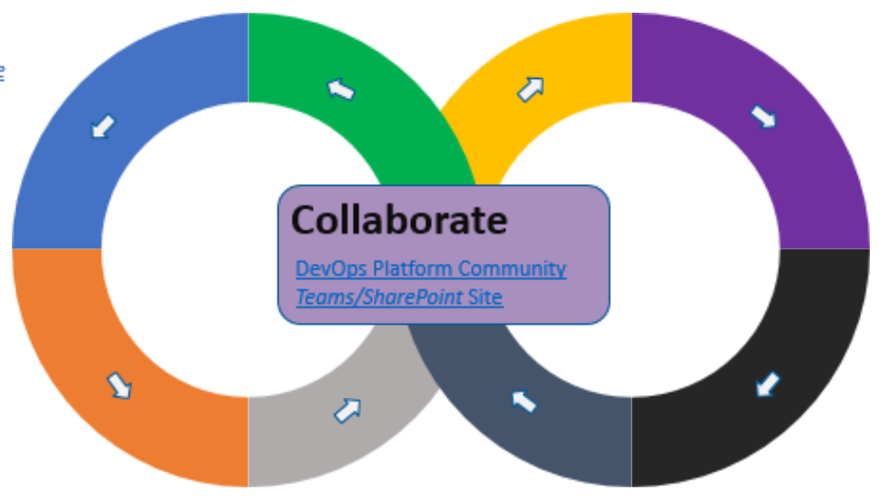
Digital Bay management
6
Process
Evaluated market options
Solution
Future state
Digital task lists
Monitors, kiosk and supervisor dashboard
Flagged delays to support / intervention
Prescriptive delivery of tasks and control over order of work
Suncor Devops standard tools
Current state
Binders with paper work orders
Union, non-union, historical challenges
No ability to flag delays
No view of shop for supervisor without walking floor and talking to each bay
Paper feedback loop to planners
Union, non-union, historical challenges
Custom DevOps solution to ensure value driven feature approach
Technology strategy to help drive scalability, system performance, feature release and integration.
Driving value through increased wrench time and physical availability

Slide 7
7
What is different?
Agile vs. waterfall
Little involvement with development
Difficult to make changes previously
Meeting customer needs through quickly-tested value–driven features
What is the opportunity for the build team?
Effective and satisfied teams
See results of efforts quickly
Feeling of making a difference in the business
What is the opportunity for the customer?
Quickly turning ideas into action
Confidence in a reliable product
What is exciting about this new way of working?
Snowball effect: As customers see results, new ideas are inspired. Positioned to be nimble and effective.

Slide 8
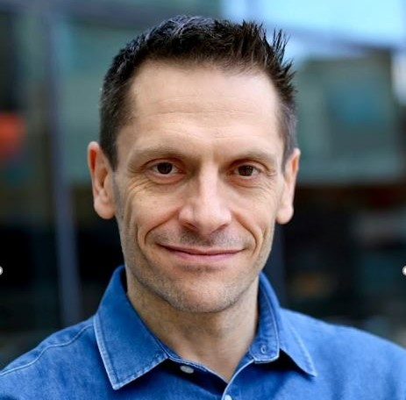
Introducing automation: challenges and treatments
Many, many, many departments to work with
“Can’t we just buy this?”
Development was a new muscle
Shifting technology stack to more DevOps-friendly; the CI/CD Pipeline
Breaking down traditional thinking in delivering projects
Notes:
Our operations include:​
Oil sands development & upgrading​
Conventional and offshore production​
Petroleum refining​
Product marketing (Petro-Canada)​

Slide 9
Where do we go from here?
We are in the early stages of our journey…
Ongoing maturation of our DevOps capabilities
Entrenching the product model across Suncor’s digital footprint
Focusing on cost reduction and value accretion
Poster child for delivery approach
Business pull for more and more
Notes:
Our operations include:​
Oil sands development & upgrading​
Conventional and offshore production​
Petroleum refining​
Product marketing (Petro-Canada)​

Slide 10
Questions?
John Hill
Lindsey Deluca
Joey Roa

Slide 11
Appendix

Slide 12
We cannot achieve our purpose and become a people-focused, high performing organization without deep and ongoing care for our people.
Guided by our values, we are creating a culture founded on trust and inclusion. It means making Suncor a great place to work for everyone, where people feel safe, included, inspired, trusted and supported, so they can be and bring their best.

Slide 13
